Slide 1
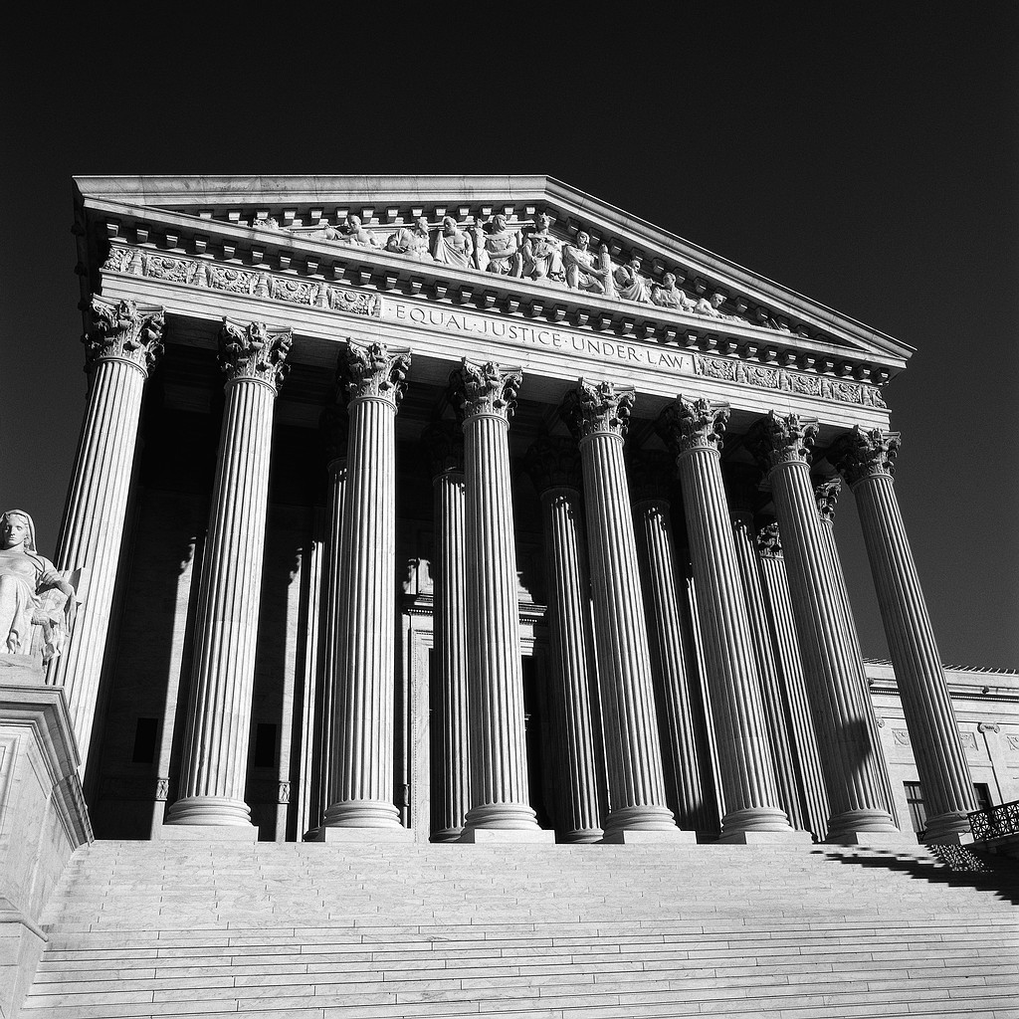
Chapter 13 Vocabulary
The Bureaucracy
Created by: Britany Stergos

Slide 2
Authorization legislation
Legislative permission to begin or continue a government program or agency. An authorization bill may grant permission to spend a certain sum of money, but that money does not ordinarily become available unless it is also appropriated. Authorizations may be annual, multiyear,or permanent. See also Appropriation

Slide 3
Annual authorizations
See Authorization

Slide 4
Bureaucracy
A large, complex organization composed of appointed officials. The department and agencies of the U.S. government make up the federal bureaucracy.

Slide 5
Committee clearance
The ability of a congressional committee
to review and approve certain agency decisions in advance and without passing a law. Such approval is not legally binding on the agency, but few agency heads will ignore the expressed wishes of committees.

Slide 6
Competitive service
The government offices to which people
are appointed on the grounds of merit as ascertained by a written examination or by having met certain selection criteria
(such as training, educational attainments, or prior experience).

Slide 7
Discretionary authority
The extent to which appointed bureaucrats can choose courses of action and make policies that are not spelled out in advance by laws.

Slide 8
Iron triangle
A close relationship between an agency, a congressional committee, and an interest group that often becomes a mutually advantageous alliance. See also Issue network; Client politics

Slide 9
Issue network
A network of people in Washington-based interest groups, on congressional staffs, in universities and think tanks, and in the mass media who regularly discuss and advocate public policies—say, health care or auto safety. Such networks are split along political, ideological, and economic lines.

Slide 10
Laissez-faire
An economic theory that government should not regulate or interfere with commerce.

Slide 11
Legislative veto
The rejection of a presidential or administrative agency action by a vote of one or both houses of Congress without the consent of the president. In 1983 the Supreme Court declared the legislative veto to be unconstitutional.

Slide 12
Name-request job
A job to be filled by a person whom a government agency has identified by name.

Slide 13
Red tape
Complex bureaucratic rules and procedures that must be followed to get something done.

Slide 14
Trust funds
Funds for government programs that are collected and spent outside the regular government budget; the amounts are determined by preexisting law rather than by annual appropriations. The Social Security trust fund is the largest of these. See also Appropriation
FIN <3 XD

